Slide 1

ECE 3030 Physical Foundations of Computer Engineering Transistors
Asif Khan
Department of Electrical and Computer Engineering
Georgia Institute of Technology
Notes:
Hello and welcome everyone.
It is my great pleasure giving this talk to such a distinguished audience.
My talk is about doing electronics with an advanced class of materials called ferroelectrics and complex oxides.
So let me first tell you what these materials are and why we want to use them.

Slide 2
Resources
Recorded lecture available at https://youtu.be/p_axpRrf7iQ

Slide 3
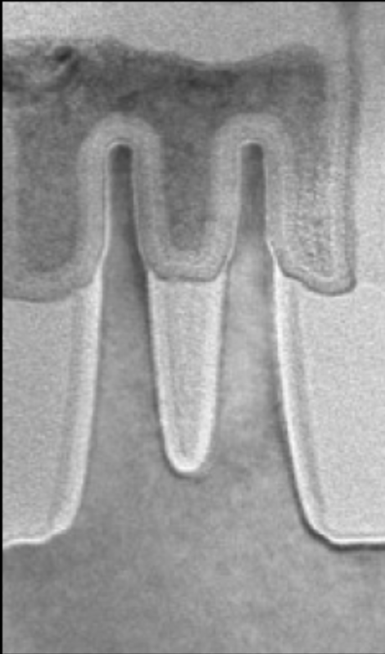
Transistors
Intel Broadwell 14 nm node, 2014
MOSFET
Metal
Oxide
Semiconductor
http://electroiq.com/chipworks_real_chips_blog/2014/
http://www.extremetech.com/computing/193200-intels-14nm-broadwell-chip-reverse-engineered-reveals-impressive-finfets-13-layer-design

Slide 4
Circuit Elements for Integrated Circuits
Materials
Metal
Dielectric/Oxide
Semiconductor
R
n-type
p-type
L
C
MOSFET
MOS Cap

Slide 5
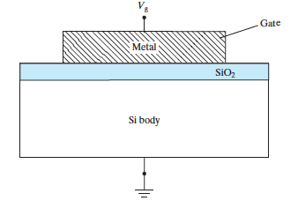
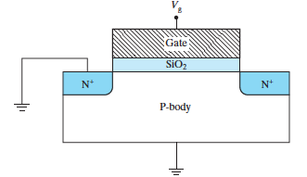
MOS Capacitors and Transistors
MOS: Metal-Oxide-Semiconductor
MOS capacitor
MOS transistor

Slide 6
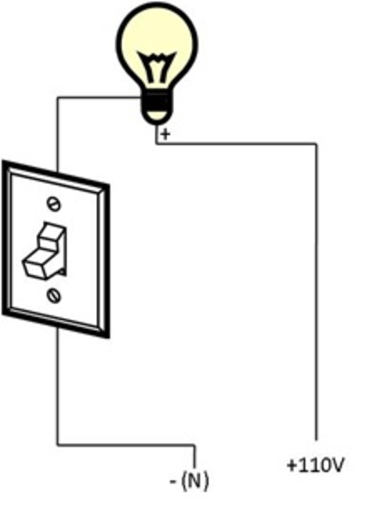
MOSFET as a Switch

Slide 7
MOSFET as a Switch

Slide 8
Analogy

Slide 9
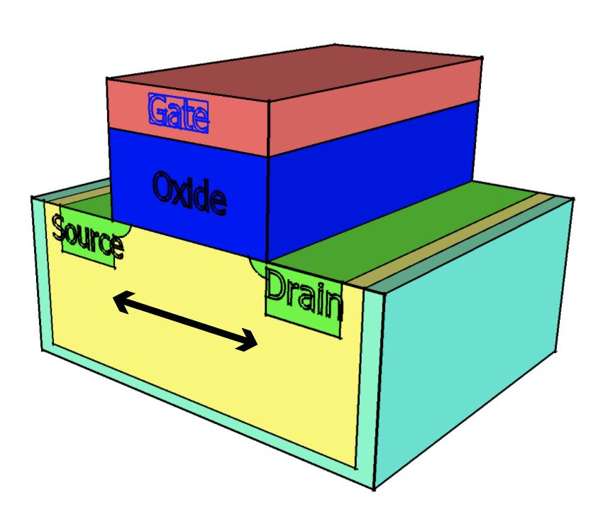
MOS Transistor as a Switch
Drain
I_{D}
Gate
Source
V_{G}
I_{D}
I_{D}
V_{D}
V_{S}

Slide 10
V_{D}
+
V_{G}
+

